Slide 1
Viewing Geometry for a Simple Ray Generator from a 3D Eye Point
Avoids OpenGL projection setup.
(Thanks to Andrew Glassner)
Geometric Situation:
Know:
Eye world coordinates: E
Viewing vector direction: C (implies viewing distance is |C| )
Up vector: U
Field of view half angles: θ and φ
Output is a screen midpoint and two vectors used to iterate over the raster positions on the target NDC space.
We’ll compute the world coordinates of any point P in the NDC space.

Slide 2
Simple Viewing Geometry
P=(s_{x},s_{y})
(1,1)
V
M
H
φ
B
U
C
(0,0)
θ
A || H
B || V
Screen coordinates are NDC
V
E
A

Slide 3
Algorithm for Required Vectors and P
A ← C × U (be sure this is well defined)
B ← A × C (B is now in the correct plane)
M ← E + C (now have midpoint of screen)
H ← (A |C| tan θ) / |A| (rescale A to H)
V ← (B |C| tan φ) / |B| (rescale B to V)
Given the origin M as shown, any point in NDC is (s_{x}, s_{y}) [0 ≤ s_{x} ≤ 1; 0 ≤ s_{y} ≤ 1)]
E.g., if frame buffer is 320 pixels wide by 240 pixels high, then (50, 75) would map to (s_{x}, s_{y}) = (50/319, 75/239).
P ← M + (2s_{x} − 1) H + (2s_{y} − 1) V
The ray equation is thus:
R ← E + t(P − E) / |P − E|
(ray direction D is normalized P − E)
So just iterate this for each pixel (integer) coordinate pair.

Slide 4
Combining Radiosity and Ray Tracing: Can it be done?
Radiosity (e.g., by finite element method): accounts for global diffuse illumination:
Get area lights, soft shadows, color bleeding, participating media.
View independent.
No arbitrary ambient terms.
But expensive meshing and form factor pre-process step.
Ray tracing accounts for local specular reflections and translucency.
View dependent
Problem is that these two computations are not really ordered nor independent, but both are essential for natural-looking (arbitrary BRDF, BTDF, and BSSDF) object rendering!

Slide 5
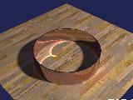
Disadvantage to Both:
Finally, neither approach can easily account for caustics: bright and shaped areas caused by the focusing and concentration of light by curved (lens-like) surfaces.
Leads to Monte Carlo Path Tracing and Photon Mapping.

Slide 6
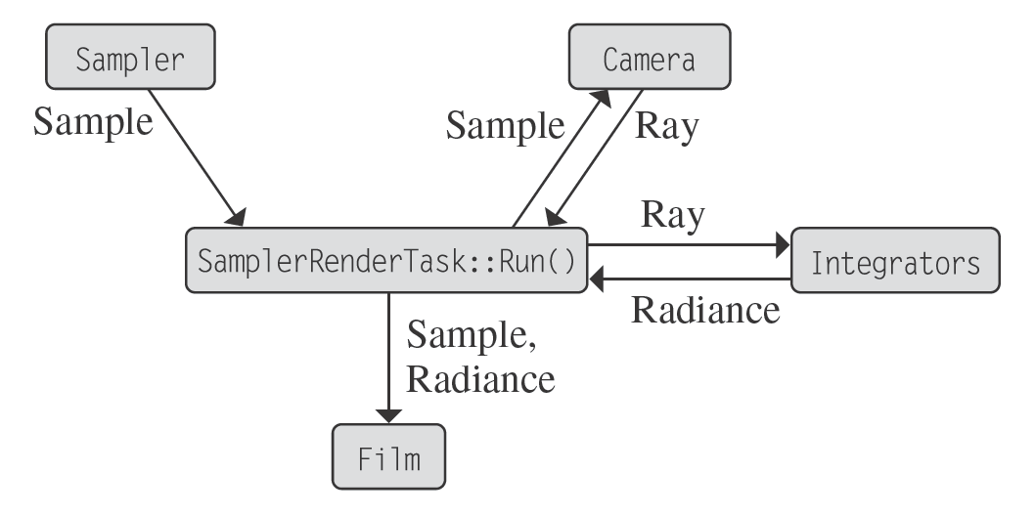
Assembling the Big Picture: Physically Based Rendering
Need radiance, sampling, ray tracing and integration!
Need to figure out what, when, and how.
Much of this material adapted from Pharr and Humphreys: Physically Based Rendering, MK, 2010

Slide 7
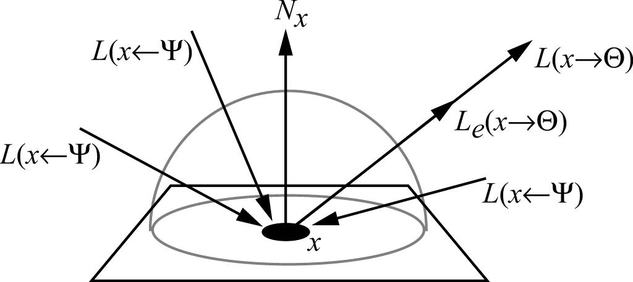
The Rendering Equation: Hemisphere Formulation
f_{r} is the Bidirectional Reflectance Distribution Function (BRDF)
for the surface at point x

Slide 8
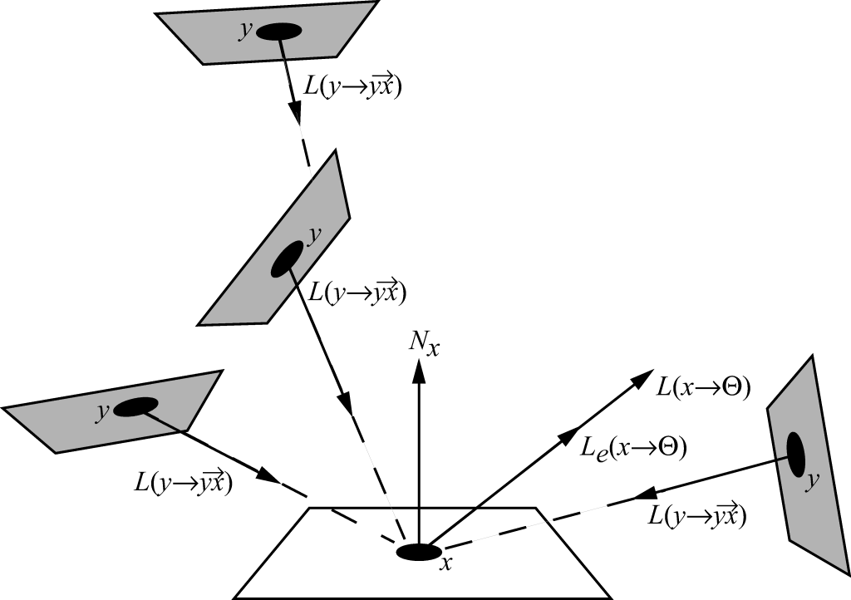
The Rendering Equation: Area Formulation
Form factor &
visibility terms

Slide 9
Integration via Randomization Algorithm
In either of these formulations we have an integral over some domain (hemisphere or surface) that looks quite complicated to solve, since it is inherently recursive.
Solution: estimate integral over a finite number of samples.
But how to sample?
Use a randomized algorithm.
But how to randomize “nicely”?
We need to look into this question before we can return to the rendering equation itself.

Slide 10
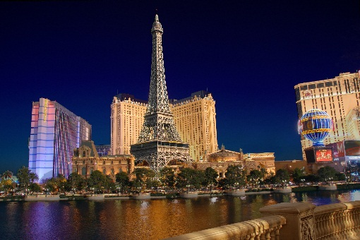
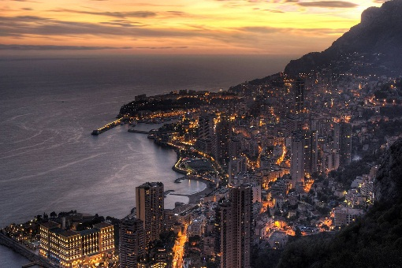
Las Vegas vs. Monte Carlo Random Sampling
Las Vegas
Always gives the same answer
E.g., QuickSort (selecting the pivot element randomly gives O(n log n) complexity, but it always converges to the sorted list whatever the pivot selection method.)
Monte Carlo
Gives the right answer on average
Used on functions that are difficult to evaluate or have no closed forms (such as our recursive integrals)
Slow convergence
But independent of dimensionality!
Artifacts manifest as noise

Slide 11
Naïve Integration via Discretization
F(x)
a
Δx
b
Can also sample via Trapezoidal or Gaussian quadrature methods: same general idea.
Good in 1D
Error is O(1/N) or O(1/N²)

Slide 12
Monte Carlo Terminology
X, Y,… random variables (chosen by a random process).
Function of a random variable is a random variable , e.g., Y=f(X).
ξ is a canonical uniform random variable which takes values in domain [0,1) with equal probability.
x, y,… random values.
Pr ≡ “Probability of”.
P(x): Cumulative Distribution Function (CDF):
p(x): Probability Density Function (PDF)

Slide 13
Example for Uniform Random Variable
Uniform p(x) for ξ
1
0
0 1
P(x)
1
0
0 1

Slide 14
Expected Value
The Expected Value is the mean or average value of the distribution:
E.g., the expected value of a cosine distribution between 0 and π:
…which is what we would expect from its graph.
+
‒

Slide 15
Expected Value Properties
Homogeneity (Linear)
Additivity (Linear)

Slide 16
Monte Carlo Estimator (Uniform random variable)
Goal: Evaluate
Let X_{i} be a uniform random variable over [a,b].
The estimator F_{N} of f(x) over the interval [a,b] is:
The PDF p(x) must be a constant and integrate to 1 over [a,b]. i.e., p(x) =1/(b-a) {check: (b-a) p(x) = 1}
The expected value E[F_{N}] of the estimator F_{N} is indeed the integral:

Slide 17
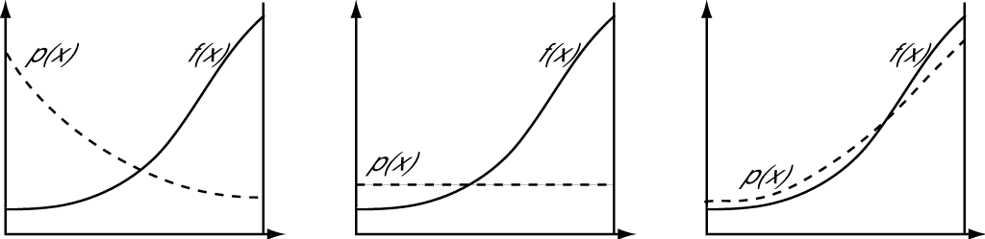
Monte Carlo Estimator (Arbitrary random variable)
If X is a random variable drawn from an arbitrary PDF p(x), then the estimator is:
Choosing a “good” PDF is important. (Imagine p(x_{i}) are “weights” that integrate to 1.)

Slide 18
Monte Carlo Estimator (Multiple Dimensions)
Suppose that N samples X_{i} are drawn from an arbitrary multidimensional (“joint”) PDF p(X), and the 3D integral is:
If samples are chosen uniformly from the box (x₀, y₀, z₀) to (x₁, y₁, z₁), then PDF p(X) is the constant
And the estimator is

Slide 19
Monte Carlo Properties
The number of samples can be chosen independently of the dimensionality of the integrand.
(Standard numerical quadrature is exponential in the dimension!)
The integral domain need not be a Cartesian box, but any domain (e.g., a hemisphere) as long as we can establish a suitable PDF.
Monte Carlo convergence rate is .
(Standard quadrature converges faster in 1D, but exponentially worse in higher dimensions.)
Monte Carlo is therefore the only practical numerical integration technique for high dimensional integrals!
Moreover, in computer graphics rendering using path tracing, the integrands are infinite dimensional!

Slide 20
So what do we need for Monte Carlo Integration?
N samples X_{i} and an “appropriate” PDF p(X_{i}):
Sampling methods include
Discrete bins
Inversion
Rejection
Metropolis (not done here)
Assume uniform random variable ξ∈[0,1) generated by a pseudo-uniform random number generator.

Slide 21
Toy Example: Discrete Bins
Generate the following PDF using ξ (note ):
Stack PDF to get CDF:
p₄
p₃
p₃
p₂
p₂
p₂
p₃
p₂
p₁
p₁
p₁
p₁
p₁
p₄
1 2 3 4
20% 30% 40% 10%

Slide 22
Toy Example: Discrete Bins
Generate a value for ξ…
Suppose ξ ∈[0.9,1), then are in p₄
Suppose ξ ∈[0.5,0.9), then are in p₃
p₄
ξ =0.96
p₃
p₃
ξ =0.71
Suppose ξ ∈[0.2,0.5), then are in p₂
p₂
p₂
p₂
ξ =0.32
Suppose ξ ∈[0,0.2), then are in p₁
p₁
p₁
p₁
p₁
ξ =0.11

Slide 23
Inversion Method (If CDF is continuous and invertible)
Get PDF p(x)
Compute CDF
Compute inverse P⁻¹(x)
Get ξ
Compute X=P⁻¹(ξ)
1
ξ =0.3
PDF
CDF
X

Slide 24
Example: Power Distribution (arises from microfacet model)
Sampling from the power distribution

Slide 25

The Rejection Method (Throw darts)
Can’t integrate f(x) to find its PDF?
Can’t analytically invert its CDF?
p(x) is “ugly” or “weird” or just complicated?
Then throw darts at it!
Suppose f(x) < (c p(x)) for some constant scalar c and we know how to sample from p(x).
loop forever:
sample X from p’s distribution
if ξ < f(X) / (c p(X)) then
return X
Works for any number of dimensions.
c*p(x)
ξ₂
ξ₁
f(x)
x₂
x₁

Slide 26
Examples of Rejection Sampling
Uniformly sample a disk (embedded in a unit square) by rejection sampling.
(Result IS uniform but “clumpy” in undesirable ways. Recall stratified sampling discussion.)

Slide 27
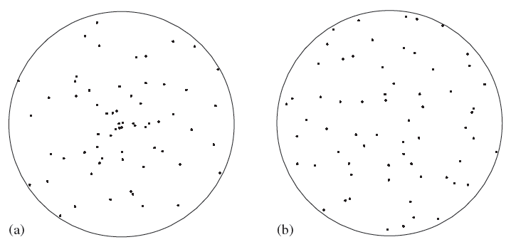
Direct Approach to Disk Sampling
Compute samples uniformly over a unit disk in polar coordinates.
An obvious sampling strategy is but this causes samples to “clump” toward the disk center (a).
Without proof, a good uniform sampling function for the unit disk is (b):
(The counteracts the disk “clumping”.)
(a)
(b)

Slide 28
Monte Carlo Integration: Sampling over a Hemisphere
We need to sample irradiance due to a light source over a hemisphere:
How to do this?

Slide 29
Sampling over Spheres and Hemispheres
Uniform direction samples over a complete sphere:
And uniform samples over a hemisphere:

Slide 30
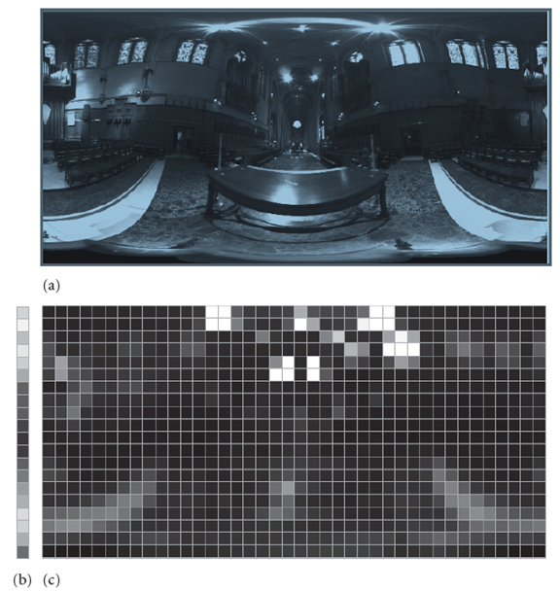
Sampling 2D Piecewise-Constant Functions (Used for texture maps and environment maps)
(a) The original HDR environment map [u,v].
(b) A low-resolution version of the row-wise [v] density function.
(c) The piece-wise constant distributions for rows of the image.
First (b) is used to select a row [v] of the image to sample. Rows with bright pixels are more likely to be sampled.
Then, given a row, a value u is sampled from that row’s 1D distribution.
(HDR map from Paul Debevec.)
↑
v
(a)
u→
(b) (c)

Slide 31
Back to Monte Carlo Path Tracing
Summary
Choose sample paths according to an appropriate Probability Density Function.
Evaluate function at sample.
Average these appropriately weighted values.
Error ⇒ slow convergence (twice as good ⇒ need 4 times more samples).
Variance in estimator ⇒ noise in image.
Good for high dimensional functions.
Theoretically best we can do (good estimator and more samples ⇒ better image).

Slide 32
Monte Carlo Path Tracing
Estimate radiance value as (appropriately chosen and weighted average of (lots of) random paths along rays from eye through [each] pixel.
Compute radiance value for each visible point from Rendering Equation:
Self Emission
Direct Illumination (shadow rays)
Indirect Illumination (Recursive)
Keep lengths of recursive paths manageable – Russian Roulette.
Cutler & Durand, MIT

Slide 33
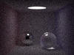
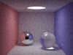
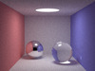

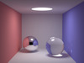

More Samples = Higher Cost but Less Noise!
8 samples/pixel 40 samples/pixel 200 samples/pixel
13 sec 63 sec 5 min
1K samples/pixel 5K samples/pixel 25K samples/pixel
25 min 124 min 10.3 hrs
2.4 GHz Intel Core 2 Quad CPU using 4 threads. See www.kevinbeason.com/smallpt

Slide 34
Evaluating the Radiance Arriving at the Eye
pixel-wise sampling filter
emitted
reflected light
estimator for reflected light
Recursive step

Slide 35
How to Stop Recursion?
Typically use “Russian Roulette”
Unbiased
Absorption probability P: α =1−P
α is proportional to hemispherical reflectance
Check:
black non-reflective surface, α = 0, P = 1, so recursion must stop here;
mirror (specular) surface, α = 1, P = 0, so recursion cannot stop here.
Threshold (fixed or adaptive)

Slide 36
Direct Illumination: First Option
Sample each light source separately
Possible PDFs:
Uniform light area sampling
Uniform sampling of solid angle subtended by light source

Slide 37
Direct Illumination: Second Option
Combine light sources as one integral domain
PDFs:
Uniform source selection; uniform sampling of light area.
Power proportional source selection; uniform sampling of light area.
Works better for “natural” light scenes (non-discrete sources), e.g., an HDR light field environment map.

Slide 38
Indirect Illumination
Uniform hemisphere sampling
Importance sampling (PDF choice) of any of the following:
Cosine
BRDF
Incident radiance
A combination of any of the above

Slide 39
Importance Sampling
Variance dependent upon the choice of PDF of the estimator.
Importance sampling the integral means taking samples that are likely to contribute most significantly to the result.
Reminds one of progressive radiosity method.

Slide 40
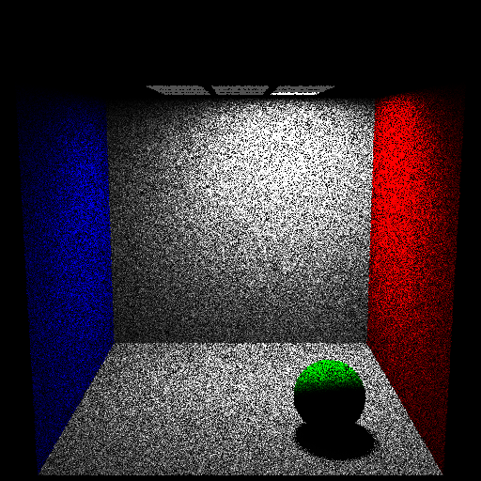
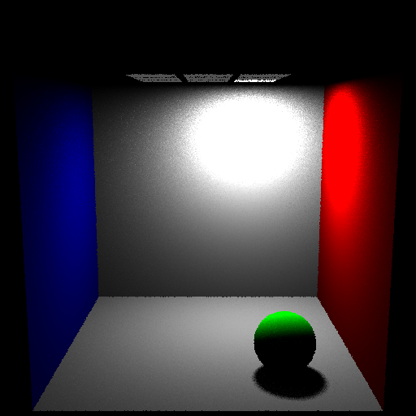
Multiple Light Source Sampling
Uniform Light Source Sampling Power based Light Source Sampling
1 path per pixel – 1 shadow ray per point – Direct Illumination Only

Slide 41
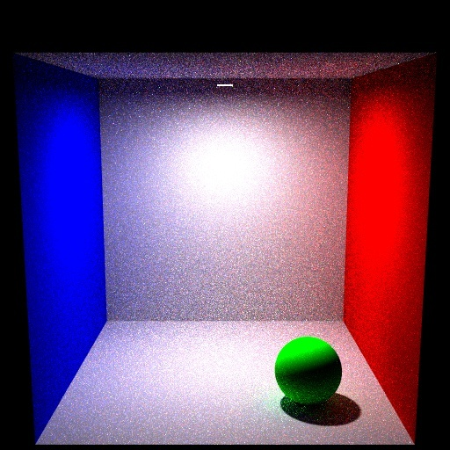
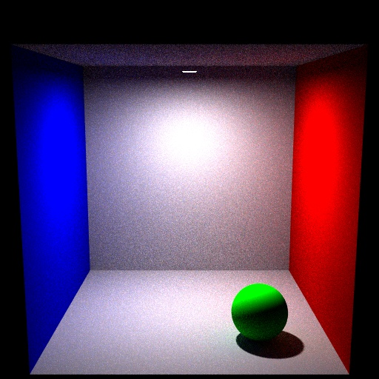
Importance Sampling: Cosine
Uniform Sampling of Hemisphere Importance Sampling (cosine) of Hemisphere
49 paths per pixel – 1 shadow ray per point – Max eye path depth = 10
Direct + Indirect Illumination

Slide 42
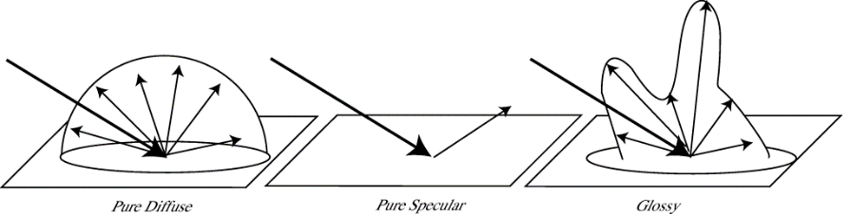
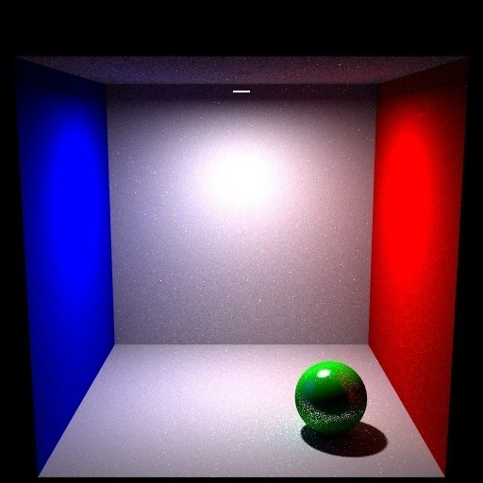
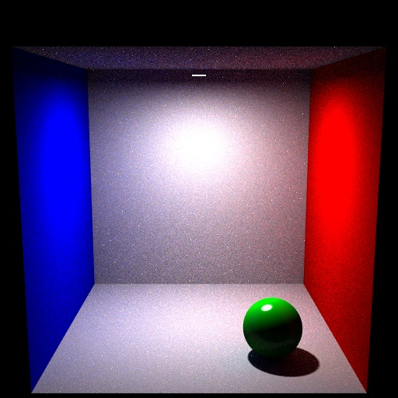
Importance Sampling: BRDF
Uniformly sampling a directional
BRDF produces noise
Uniform Sampling of BRDF Importance Sampling of BRDF
49 paths per pixel – 1 shadow ray per point – Max eye path depth = 10
Direct + Indirect Illumination

Slide 43
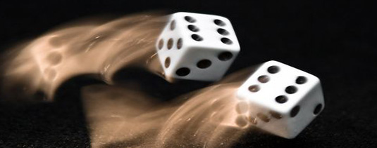
Temporal Anti-Aliasing -- Motion Blur
Blur image of moving object to combat high frequency jerkiness or strobing caused by frame-rate sampling.
Earliest work in 1984:
Korein and Badler did spheres and polygons.
Lucasfilm introduced spatial and temporal “noise” into ray-tracing: Monte Carlo or distribution path tracing.
Also applied to camera depth-of-field
http://acrisdesign.com/2009/10/60-marvelous-motion-blur-photos-for-inspiration/

Slide 44
Monte Carlo Path Tracing and Temporal Anti-Aliasing
Extend Monte Carlo path trace into time domain.
Because a small amount of noise is added, it is best to supersample and filter.
Can also do camera depth-of-field

Slide 45
Monte Carlo Path Tracing in Time/Camera Space
light
sample
point
surface
image
plane
lens
For each primary ray:
1. Jitter spatial location on image plane within the pixel.

Slide 46
Monte Carlo Path Tracing in Time/Camera Space
light
sample
point
surface
image
plane
lens
For each primary ray:
2. Jitter time T within inter-frame interval.

Slide 47
Monte Carlo Path Tracing in Time/Camera Space
light
sample
point
surface
image
plane
lens
For each primary ray:
3. Move camera and objects to position at that time T.

Slide 48
Monte Carlo Path Tracing in Time/Camera Space
light
sample
point
surface
focal
point
image
plane
lens
For each primary ray:
4. Determine focal point.

Slide 49
Monte Carlo Path Tracing in Time/Camera Space
light
sample
point
surface
focal
point
image
plane
lens
For each primary ray:
5. Jitter lens location.

Slide 50
Monte Carlo Path Tracing in Time/Camera Space
light
sample
point
surface
focal
point
image
plane
lens
For each primary ray:
6. Determine surface intersection via standard ray trace
with rays going through sampled lens point and focal point.

Slide 51
Monte Carlo Path Tracing in Time/Camera Space
light
sample
point
reflected
ray
surface
focal
point
image
plane
lens
For each primary ray:
7. Trace reflection ray, importance sampling according to BRDF.

Slide 52
Monte Carlo Path Tracing in Time/Camera Space
light
sample
point
surface
focal
point
image
plane
lens
refracted
ray
For each primary ray:
8. Trace a refraction ray, if appropriate, sampling according to specular transmission function (STDF).

Slide 53
Monte Carlo Path Tracing in Time/Camera Space
light
sample
point
surface
focal
point
image
plane
lens
For each primary ray:
9. Trace shadow ray, sampling location on light based on light (power) distribution function.

Slide 54
Monte Carlo Path Tracing in Time/Camera Space
sample
point
surface
focal
point
image
plane
lens
Look at another possible sample for the same pixel...
Notice how the MC distribution samples some other contributing
but possibly VERY DIFFERENT part of the scene.

Slide 55
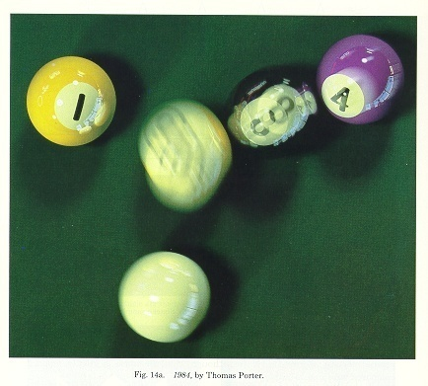
Monte Carlo Path Tracing With Temporal Anti-Aliasing

Slide 56
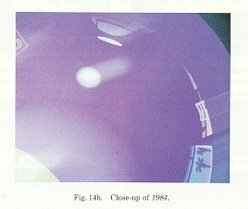
Detail from the Example

Slide 57
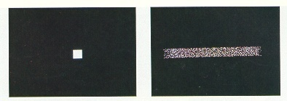
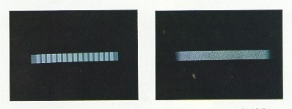
Motion Blur Test Cases
regular grid, 1 sample/pixel jittered grid, 1 sample/pixel
regular grid, 16 samples/pixel jittered grid, 16 samples/pixel

Slide 58
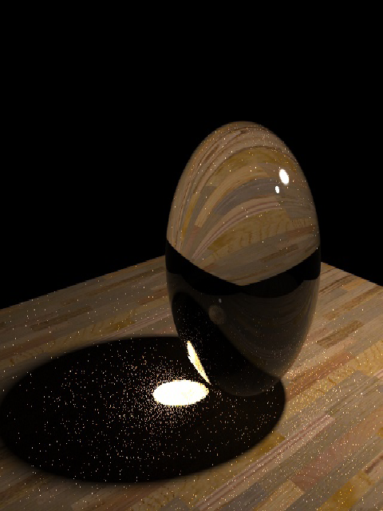
Monte Carlo Path Tracing: Pros and Cons
Pro:
Arbitrary geometry – point primitive.
Very low memory consumption.
Theoretically “best” possible with infinite (time) resources.
Paths in both time and space.
Con:
View dependent (paths start at eye).
Does not reuse illumination information.
Not efficient for diffuse surfaces.
Slow.
Noisy.
Expensive on caustics.

Slide 59
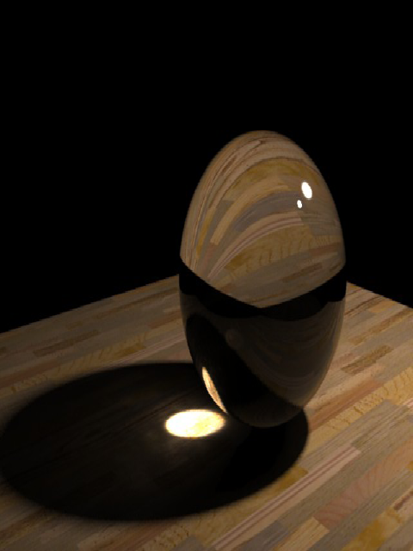
Photon Mapping
Based on work by Henrik Wann Jensen:
For efficiency re-use illumination like finite-element (radiosity) methods, but do not pre-mesh (hence compute no form factors)!
Retain other characteristics of Monte Carlo (recursive) path tracing.
Subjective perceptual quality trade-off: Blur is better than noise!

Slide 60
Photon Mapping
Main idea: Decouple illumination information from geometry
Store (and re-use) radiance information plus incoming directions as points on surfaces;
do this efficiently so we can readily find neighboring samples;
Smooth discrete illumination samples via filtering.
Reverse of ray-tracing: This is, trace light in the direction it flows (photon-like).
Need to insure an adequate number of photons are emitted from light sources to “cover” the entire scene.
Initially this was thought to be prohibitively expensive to compute: How many photons do you need to guarantee everything is covered? Millions? Trillions? More??

Slide 61
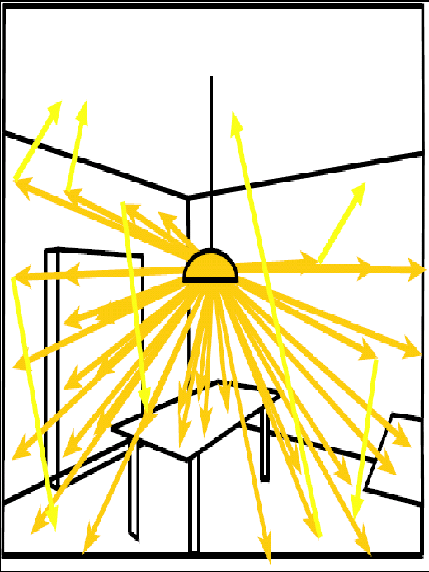
Key Properties of Photon Mapping
Like radiosity, handles global illumination, diffuse inter-reflections (color bleeding), and participating media, but also does non-diffuse surfaces and caustics better.
And like radiosity, the photon map is view independent! (Irradiance/colors are “baked on”.)
But unlike radiosity, no pre-radiosity patch meshing is used.

Slide 62
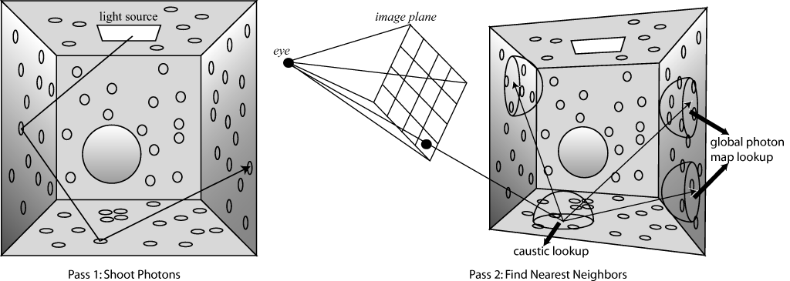
Two Principal Steps in Algorithm
Emit photons into the scene and store them in a photon map when they encounter a non-specular surface.
Render using statistical methods to estimate locally (at any point) irradiance and reflected radiance from the photon map.
Pass 1: Shoot Photons Pass 2: Find Nearest Neighbors

Slide 63
Three Photon Maps
Global photon map: approximates global illumination for all diffuse surfaces.
Caustic photon map: contains photons experiencing at least one transmission before hitting a diffuse surface.
Volume photon map: used for participating media.
A separate caustic rendering step requires higher quality (more photons) data.
Photon maps are converted to balanced K-d trees in time O(N log N); this allows finding specific nearest K neighboring photons during the rendering pass with O(K+log N) search time.

Slide 64
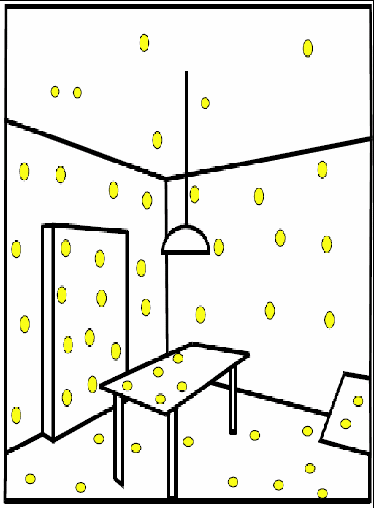
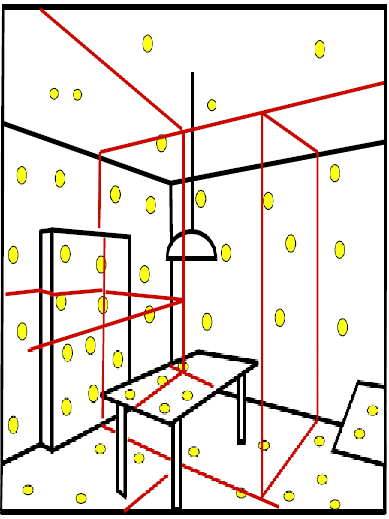
Exploit K-d Tree Spatial Data Structure
Index photon hits on geometry via K-d tree (essentially about equal numbers of hits per cell volume).
Idea is to collect neighboring cached photons quickly!
Photon caching Spatial data structure (K-d tree)

Slide 65
Photon Tracing
Trace emitted photons through scene (“backward ray tracing”) except photons propagate flux (power/radiosity).
(Rather than ray tracing which gathers reflected light as the recursion unwinds.)
Photons interact with materials differently than rays (e.g., refraction does not effect photon flux).
Photon interactions with a surface or object are computed probabilistically from material properties.
Reflected (BRDF)
Transmitted (BTDF)
Absorbed (ends trace for this photon – decided via “Russian roulette”, exactly as in Monte Carlo path tracing)

Slide 66
Handling Mixed Diffuse and Specular Surfaces
Most surfaces have both specular and diffuse components in their BRDF:
ρ_{d} is diffuse reflectance
ρ_{s} is specular reflectance
ρ_{d} + ρ_{s} < 1 (conservation of energy)
When photon hits this surface, compute a uniform random value 0 ≤ ζ ≤ 1:
If ζ < ρ_{d} then reflect diffuse
Else if ζ < ρ_{d} + ρ_{s} then reflect specular
Otherwise absorb photon
ρ_{d} = 50%
ρ_{s} = 30%
_{Absorb = 20%}

Slide 67
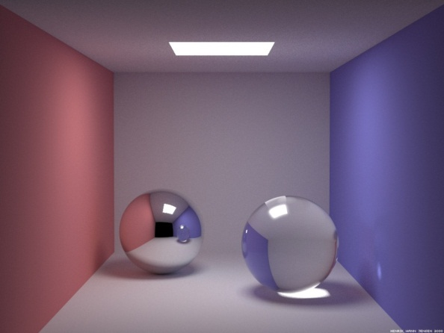
Sample Photon Paths
3 photon paths in a scene inside the Cornell box. Chrome sphere on left and glass sphere on right.
(a) two diffuse reflections then absorption.
(b) one specular reflection followed by two diffuse reflections.
(c) two transmissions then absorption (cached on caustic map).
a
c
b

Slide 68
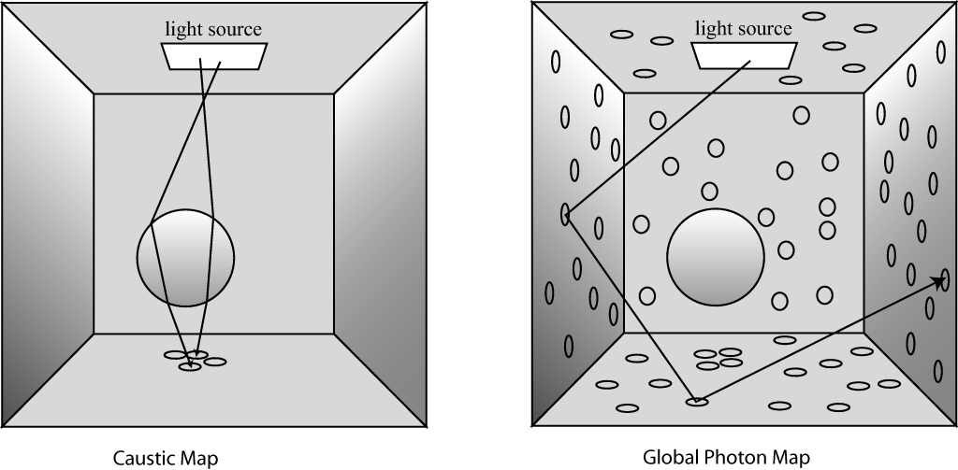
Photon and Caustic Maps Accumulate “Hits”: Incoming Direction and Irradiance
Caustic Map Global Photon Map

Slide 69
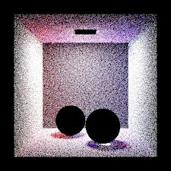
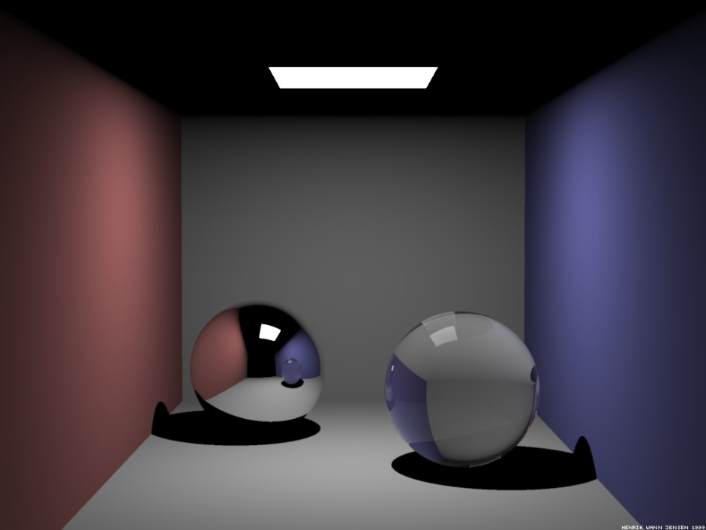
“Cornell Box” with Chrome and Glass Spheres
Ray-traced image Photons in photon maps
Every pixel accounted for Can’t guarantee complete coverage

Slide 70
Photon Storing
Photons stored whenever they hit diffuse (non-specular) surfaces.
Photon can be stored several times along its path.
Photon information also stored where absorbed.
Stored:
Position (x,y,z) and incident direction (x,y,z) of hit
Incoming photon power (magnitude in watts)
Color (r,g,b)
Housekeeping flag for photon map K-d tree data structure
Overall, ~20 bytes per photon.
Storage cost: #photons × #bounces × 20 bytes (not too bad)
We’ll see later what #photons might be.

Slide 71
Photon Emission
Distribution of photons corresponds to distribution of emissive power P (“wattage”):
For multiple sources it is desirable that all emitted photons have about the same power, thus n_{emitted-photons} will vary from emitter to emitter.
E.g., for a 60W bulb sending out 100K photons, each has 0.6mW flux.

Slide 72
Photon Distribution Models Emitter Type
Diffuse light source: photons emitted in uniformly distributed random directions.
Directional light (outside the scene): photons emitted in that direction.
Area emitter*: photons emitted in cosine distribution (maximum at normal direction).
General distributions in shape and direction.
θ
* E.g., rectangular area emitter with power Φ and n photons:
Cosine power distribution: each photon gets (1/n) Φ cos θ

Slide 73
Projection Maps in Photon Emission
Projection maps: a discrete cellular (2D array) map of the geometry as seen from the light source (compare with the hemicube of radiosity) – only photons that hit cells with geometry in them are emitted.
Planar projection map for directional light; spherical map for point light.
Identify specular objects in cells (for generation of caustics).

Slide 74
Radiance Estimate
Photon map is an estimator of incoming flux (irradiance) to a surface.
To compute irradiance we need to integrate (average) this information over a small area.
Do integration by locating a set of m photons that are closest to the point for which we wish to compute irradiance. (Here, e.g., m = 3; generally 50 ≤ m ≤ 500.)
Use cone-shaped filter to bias estimate toward photons nearest the center of the sampling disk. (Can use other filters; e.g. Gaussian.)
Various methods to select and optimize the number of photons needed for the estimate (a function of accuracy required, e.g.).
(Need to be careful at edges and corners!)

Slide 75
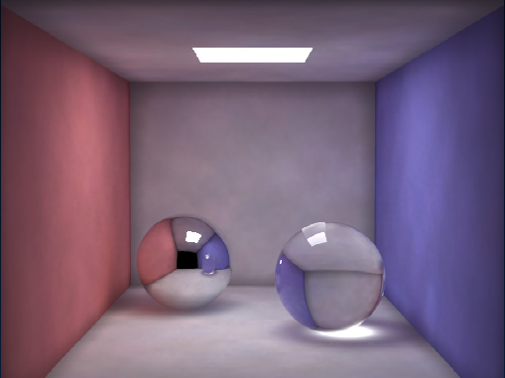
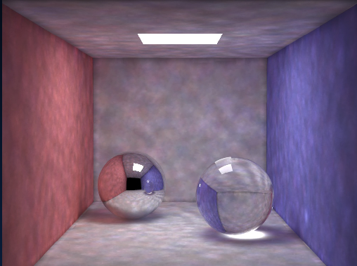
Number of Samples Matters
50 photons/area 500 photons/area

Slide 76
Cone Filter
Reflected light cone weight BRDF(incoming – reflected)
k = cone scale factor relative to cone volume (k = 1 fails to count samples at radius r, k is probably >1)

Slide 77
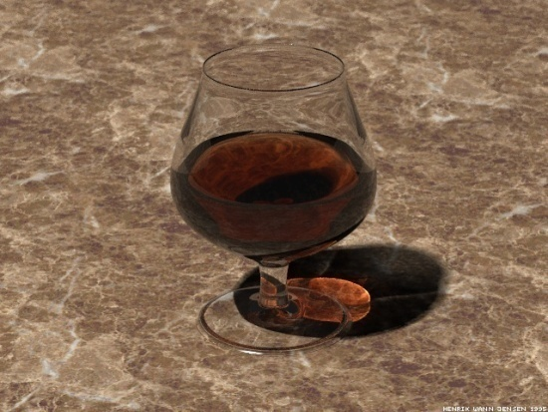
Rendering
Rendered by distributed ray tracing (rays gather irradiance).
When ray hits first diffuse surface…
Compute direct irradiance from light sources
Compute reflected radiance of caustic map photons, ignoring global map photons
Importance sample BRDF f_{r}
Use global photon map to importance sample incident radiance function L_{i}
Evaluate reflectance integral by casting rays and accumulating radiances from global photon map
First diffuse intersection. Return radiance of caustic map photons here, but ignore global map photons
Use global map photons to return radiance when evaluating L_{i} at first diffuse intersection.

Slide 78
Photon Mapping: Computing Image (Details)
Split BRDF and incoming radiance
Specular Diffuse
Direct illumination Caustic map Diffuse

Slide 79
Computing Image
Reflected radiance is then given by specular-surface distributed ray tracing. When ray first hits surface:
RT, direct emitters, area sampled
MC RT: importance sample based on BRDF f_{r,S}
Radiance estimate using caustic map photons
MC RT: importance sample BRDF using global photon map

Slide 80

Photon Mapping – Steps, Timing, and Comparisons
Ray tracing MC Path Tracing
1.5 seconds (for reference)
Timings based on Dual P3 800MHz Linux PC

Slide 81
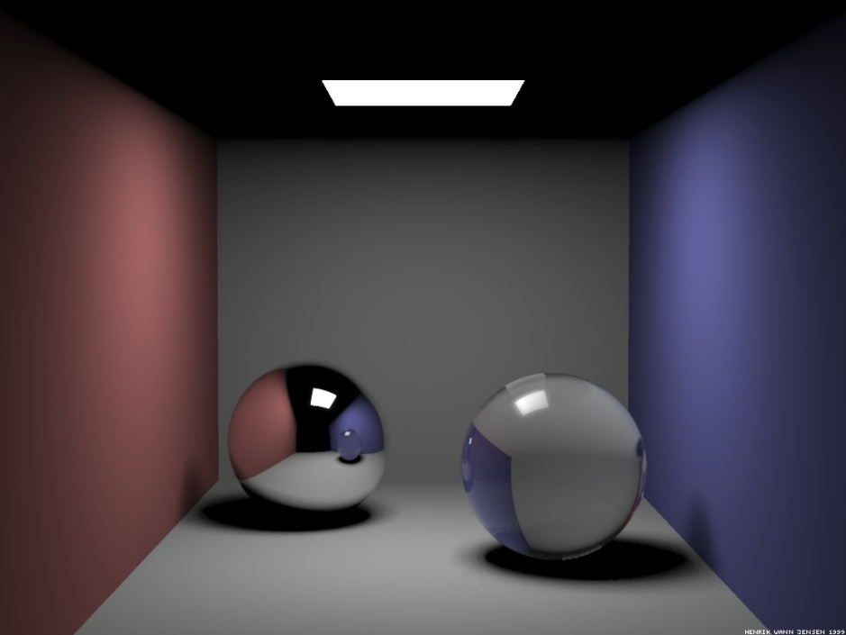
Photon Mapping
Ray tracing + Soft Shadows MC Path Tracing
1.5+5.5 = 7 seconds (for reference)

Slide 82
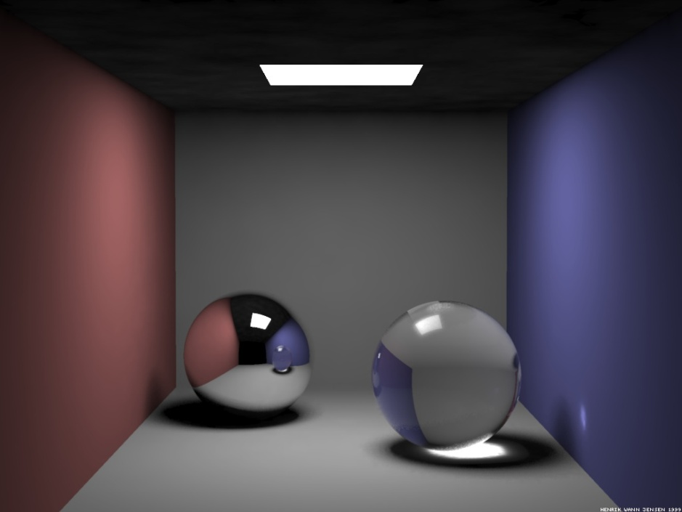
Photon Mapping
Ray tracing + Soft Shadows + Caustics MC Path Tracing
1.5+5.5+5 = 12 seconds (for reference)
50,000 hits in caustics photon map

Slide 83

Photon Mapping
Ray tracing + Soft Shadows + Caustics MC Path Tracing
+ global illumination (for reference)
1.5+5.5+5+3 = 15 seconds
200,000 photons in photon map

Slide 84
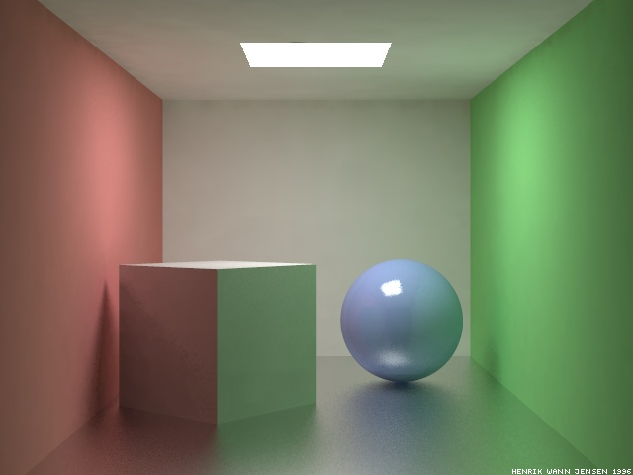
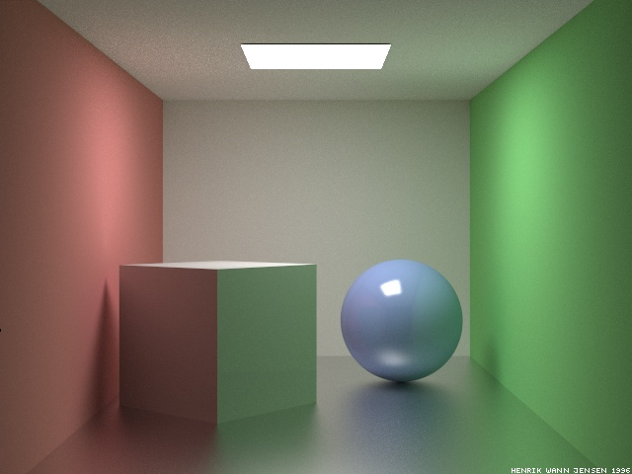
Photon Mapping
Photon Mapping (16 samples/pixel) MC Path Tracing (1000 samples/pixel)
MC Path tracing image still has noise!
Photon Mapping still has some blur.

Slide 85
Light and a Participating Medium
Model haze of smoke, dust, water vapor, or particles in air.
These can emit, absorb, reflect, or scatter light, making the participating media visible.
Divide space into voxel-like zones.
Calculate absorption, scattering, and transmittance for each zone. E.g., more scattering will make a zone more visible, thus adding haze to that volume of space.
(We already saw the transmittance formulation for volumes; this combines radiosity with volumetric rendering!)
Radiosity out
Irradiance
Scattered radiosity
(Essentially the luminosity of this volume)

Slide 86
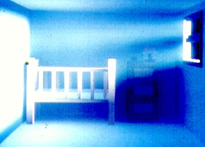
Hazy Room

Slide 87
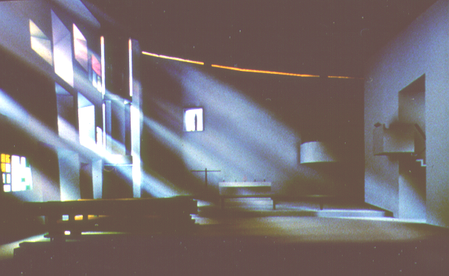
Chapel at Ronchamp
Cornell University

Slide 88
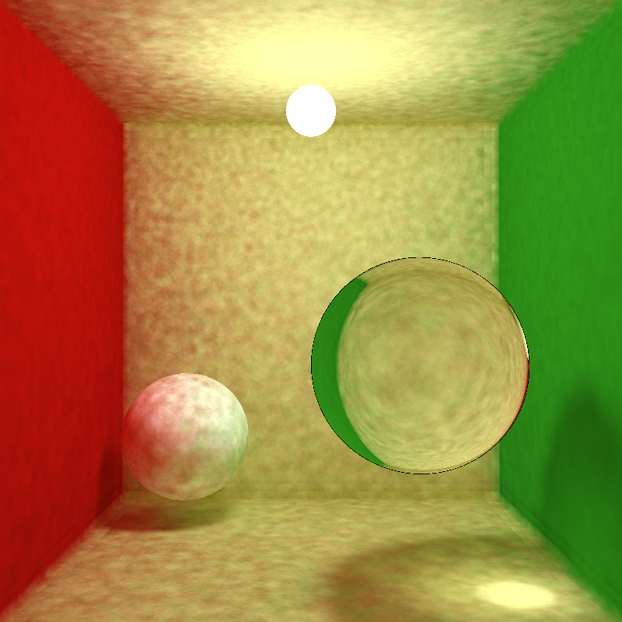
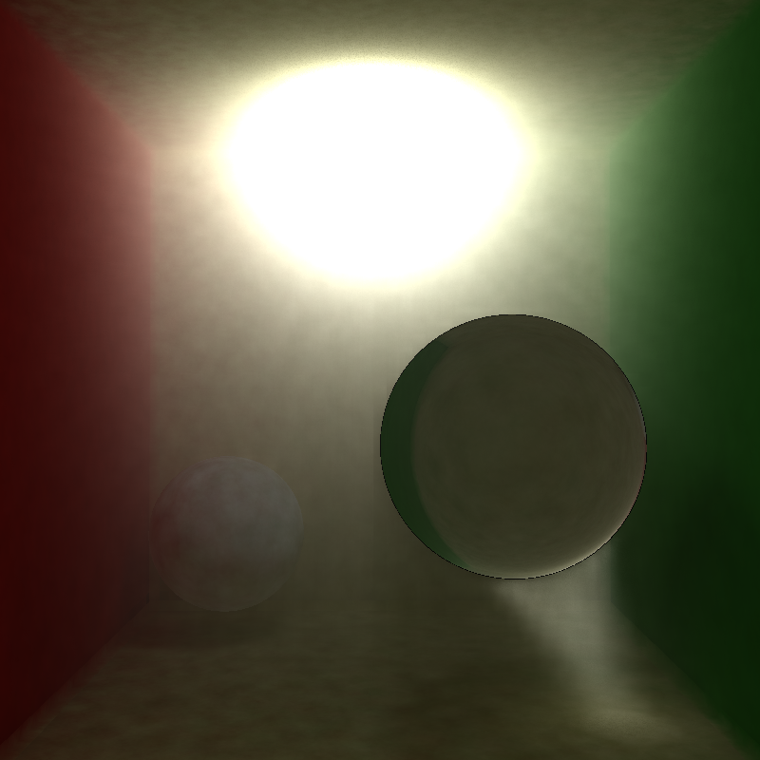
Photon Mapping in Participating Media
Without participating media With participating media

Slide 89

Visualizing the Photon Wavefront from the Light Source

